Slide 1
Chemical Compatibility of Structural Materials with Liquid Li and Sn-Li
S. Sharafat and N. M. Ghoniem
The University of California at Los Angeles (UCLA)
Los Angeles, CA. 90095-1597, USA
APEX Meeting
Argonne National Laboratory
May 10-12, 2000

Slide 2
PRESENTATION OUTLINE
Data Base of Sn-Li:
  Thermo Physical Data for Sn
  Thermodynamic Data for Sn, Li-Sn
Thermodynamics of Dissolved Solutes in Sn-Li
Chemical Stability of Oxides, Carbides, Nitrides, and Hydrides.
Uncertainties and Conclusions

Slide 3
Sn-Li Data Base
An extensive database for Sn-Li has been compiled.
Database includes:
  Thermo Physical Properties:
    Viscosity, Surface Tension, Heat Capacity, Compressibility, etc…
  Thermodynamic Properties:
    Enthalpy, Specific Heat, Entropy, Vapor Pressure.
    Heat of dissociation, reaction enthalpies, ionization potentials of various Tin-compounds.
    Sn-H, Sn-O, Sn-C Systems.
Full report is in preparation.
Notes:
Table of Contents
1. Thermophysical Properties
1. 1 Specific Volume of Sn
1. 2 Density of Sn
1. 3 Volumetric expansion coefficient (γ) of liquid Sn:
1. 4 Compressibility
1. 5 Viscosity:
1. 6 Surface Tension:
1. 7 Vaporization
1. 8 Boiling Point
1. 9 Heat of Sublimation (Ls) and Vaporization (Lv):
1. 10 Critical Pressure (pc), Temperature (Tc), and Volume (Vc)
1. 11 Heat Capacity
1. 12 Electrical Resistivity (ρ) of liquid Sn
2. Thermodynamic Properties of Sn
2. 1 Enthalpy, Specific Heat, and Entropy of Sn-Vapor
2. 2 Heat of Dissociation, Reaction Enthalpy, and Ionization Potentials of Various Tin-Compounds
2. 2. 1 Heat of Dissociation
2. 2. 2 Reaction Enthalpies
2. 2. 3 Ionization Potentials
2. 3 Thermodynamic data of Sn-silicates
2. 3. 1 Specific heat (cp) of Sn-silicates as a function of temperature
2. 4 The Sn-H System
2. 4. 1 Hydrogen Solubility
2. 4. 2 Absorption of Hydrogen
2. 4. 3 H2-Adsorption
2. 4. 4 H2-Diffusion Coefficient
2. 4. 5 Reduction of Sn by atomic hydrogen
2. 4. 6 The SnH and SnD Molecule
2. 4. 7 Solubility of the gas composition H2-CO-CO2
2. 5 The Sn-Li System
2. 5. 1 Formation of Li2SnO3*
Stability of Li2SnO3*
2. 6 The Sn-C System
2. 6. 1 Solubility
2. 6. 2 The Sn-C Molecule
2. 6. 3 The SnCO3 Molecule
2. 7 The Sn-Si System
2. 7. 1 Diffusion of Sn in solid Si
2. 7. 2 The Sn-Si Molecule
2. 8 Sn and Oxygen
2. 8. 1 Low Pressure Oxidation
2. 8. 2 Oxidation Mechanism:
2. 8. 3 Solubility of O in Sn
2. 9 The SnO-SiO2 System
2. 10 General Literature on Corrosion of Sn with Metals:

Slide 4
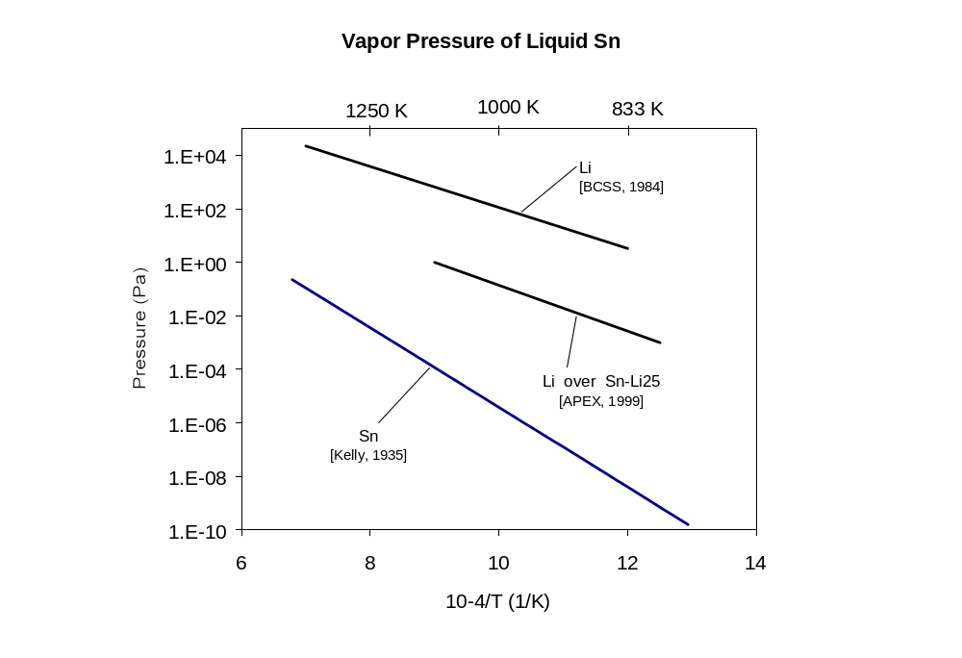
Vapor Pressure of Sn, Sn-Li 25, and Li

Slide 5
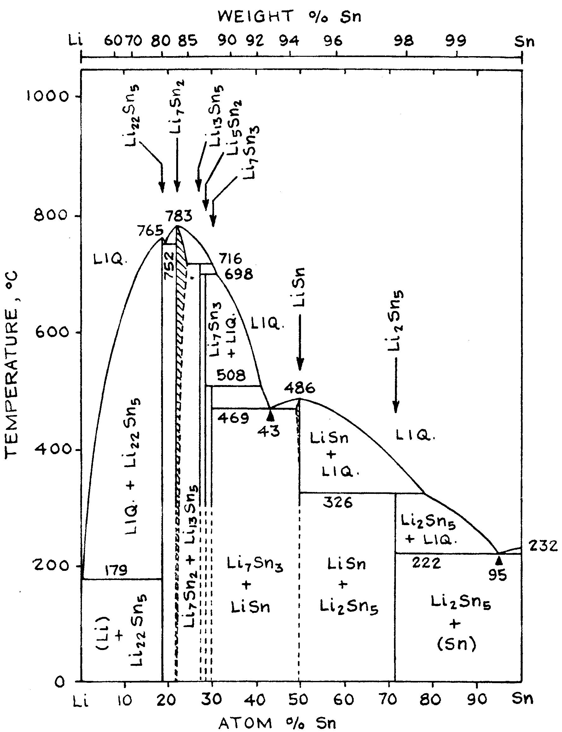
Sn-Li Phase Diagram
25 at.% Li
For Sn-Li 25at.% the minimum operating temperature has to be 330ºC to avoid formation of stable intermetallic compounds: LiSn and Li₂Sn₅.
Recent measurements* put the exact melting temperature at 334ºC.
Minimum operating temperature of the Sn-Li25 (at%) is 350ºC.
*K. Natesan, W. E. Ruther, DOE/ER-0313/27

Slide 6
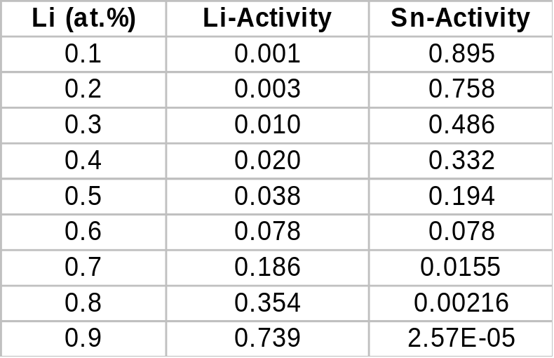
Chemical Activity of Li and Sn in Sn-Li
Existence of stable intermetallics indicates low Li and Sn activity
(a_{Li}, a_{Sn}) in some temperature ranges.
For Sn-Li the activities have been reported^{[1]} at 1200ºC:
[1] APEX-Interim Report, Nov. 1999

Slide 7
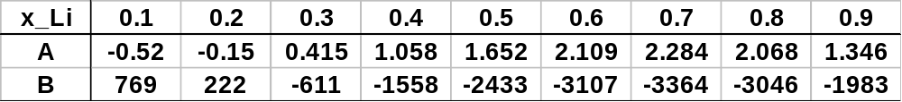
Derivation of the Activity-Temperature-Composition Relationship for Li in Sn-Li
Activity-temperature relationship for Sn-Li is expressed as:
ln a_{Li} = A + B/T (1)
  Given activity-composition relationship for Sn-Li at 1200ºC is:
  ln a_{Li} = - 8.1442 + 14.097 x_{Li} - 11.371 x_{Li}² + 6.0259 x_{Li}³ (2)
  Given the activity-composition relationship for Pb-Li data [1]:
  (3)
Determine coefficient B for Sn-Li using (1), (2), and (3):
[1] Huberstey, JNM 247(1997)

Slide 8
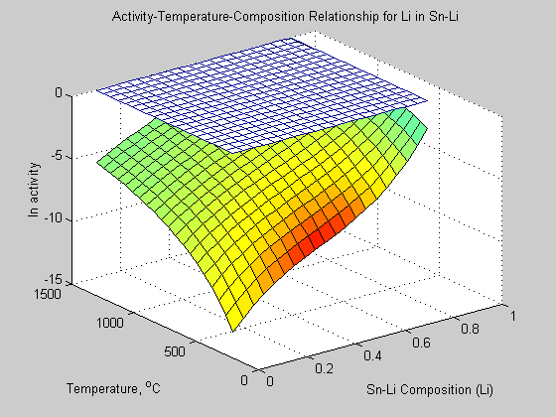
Activity-Temperature-Composition Relationship for Li in Sn-Li
Li activity decreases with decreasing Li fraction and decreasing temperature.

Slide 9
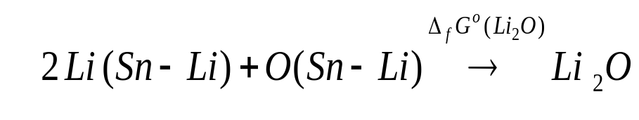
Thermodynamics of Dissolved Solutes in Sn-Li
Activity of solute (O, C, N, H) is calculated for saturated solutions under equilibrium conditions.
For the chemical reaction:
where Δ_{f}Gº is the standard Gibbs Free Energy of formation given by:
Δ_{f}Gº(Li₂O) = RT ln K_{e} = RT ln { a_{Li2O}/a²_{Li} ·a_{O}}
The activity of oxygen and the other three non-metal solutes (C, N, H) can be calculated using the standard free energy of formation:
 ln a_{O} = {−Δ_{f}Gº(Li₂O)/RT} - 2 ln a_{Li}
Data for the Gibbs Free Energy of Formation of Li₂O, Li₂C₂, Li₃N were found in the JANAF tables.

Slide 10
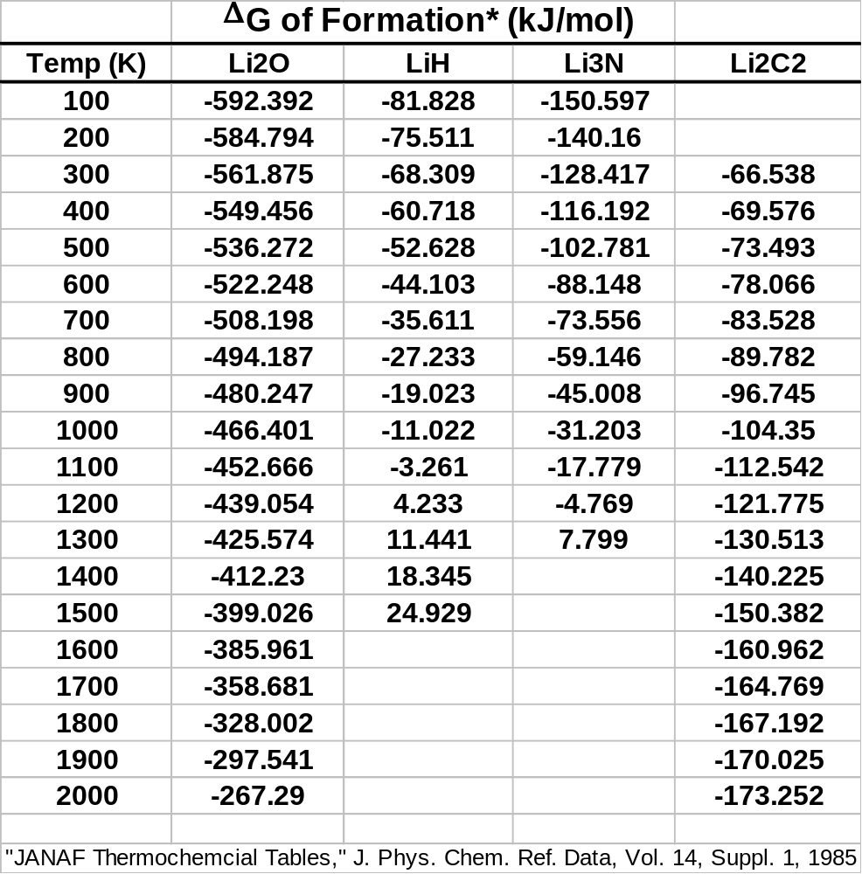
Gibbs Free Energy of Formation of Lithium-Salts*
Polynomial Fits to ΔG (kJ/mol):
ΔG(Li₂O) = 5.10910⁻⁸  T³ - 1.28610⁻⁴T²
+ 2.28210⁻¹  T - 6.20810² (100<T<2000 K)
ΔG(LiH) = -1.47410⁻⁸  T³ + 3.28510⁻⁵  T² + 5.922 10⁻²  T - 8.841 10¹ (100<T<1500 K)
ΔG(Li₃N) = -3.54910⁻⁸  T³ + 8.10910⁻⁵  T² + 8.320 10⁻²  T - 1.598 10² (100<T<1300 K)
ΔG(Li₂C₂) = 4.02610⁻⁸  T³ - 1.4190⁻⁴  T²
+ 7.573 10⁻²  T - 7.956 10¹ *JANAF-Tables (300<T<2000 K)

Slide 11
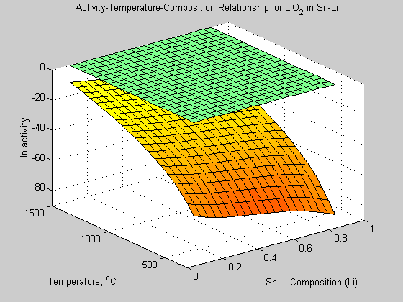
Activity-Composition-Temperature Relationship of Li₂O in Sn-Li
Activity of O in saturated solutions: ln a_{O} = {-Δ_{f}Gº(Li₂O)/RT} –2 ln a_{Li}
Activity-Temperature-Composition Relationship for Oxygen in Sn-Li
Oxygen activity increases with decreasing Li activity and with
increasing temperature (see Slide 15)
Oxygen activity is low (ln a_{O} is large and negative) throughout the composition and temperature range:Li₂O formation is favored

Slide 12
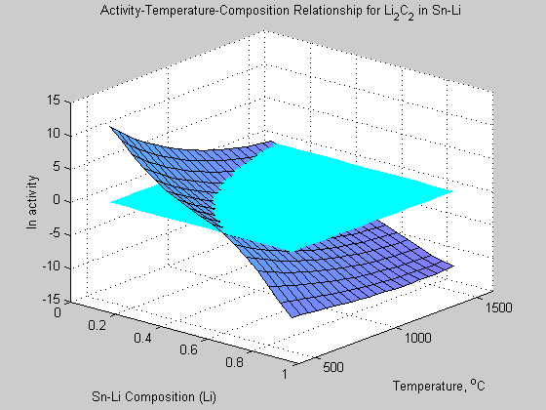
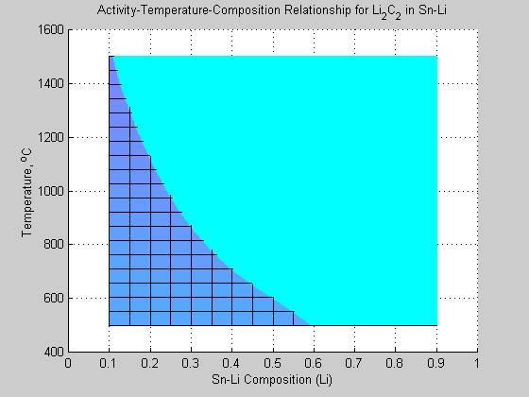
Activity-Composition-Temperature Relationship of Li₂C₂ in Sn-Li
Activity-Temperature-Composition Relationship for Carbon in Sn-Li
Carbon activities increase above unity (from – to + with decreasing Li fraction)
Hence Li₂C₂ is not stable
and decomposes
Li₂C₂ Unstable
Stable
Stable Formation of Li₂C₂
(Dissolution of Carbide Coatings)
Activity of C for saturated solutions:
ln a_{C} = {-Δ_{f}Gº(Li₂C₂)/RT} –2 ln a_{Li}
Li₂C₂ Unstable
Carbide-Coatings are resistant to dissolution

Slide 13
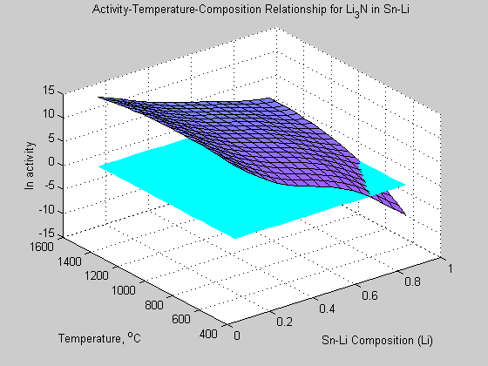
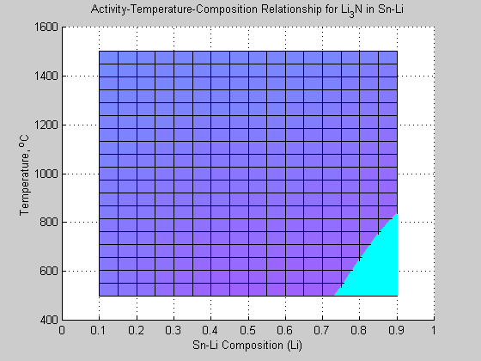
Activity-Composition-Temperature Relationship of Li₃N in Sn-Li
Activity-Temperature-Composition Relationship for N in Sn-Li
Nitrogen activities are positive for almost all of the Li-fraction and temperature ranges of interest.
Hence Li₃N is not stable and decomposes
Li₃N Unstable
Stable
Unstable Region
(Li₃N Formation Suppressed;
Nitride-Coatings are resistant to dissolution)
Li₃N
Formation
Activity of N for saturated solutions:
ln a_{N} = {-Δ_{f}Gº(Li₃N)/RT} –2 ln a_{Li}

Slide 14
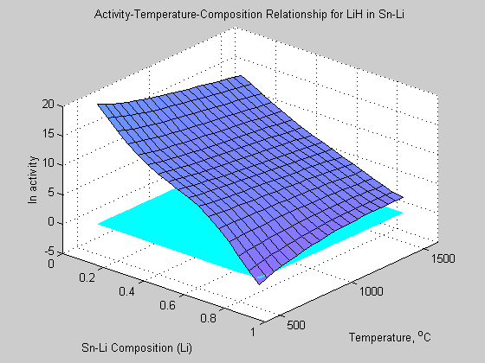
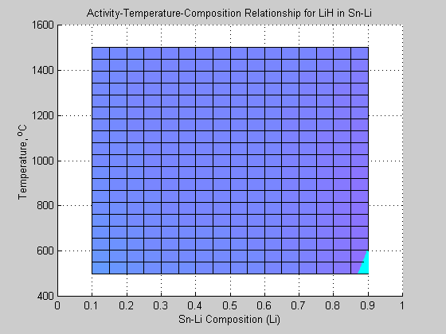
Activity-Composition-Temperature Relationship of LiH in Sn-Li
Activity-Temperature-Composition Relationship for H in Sn-Li
Hydrogen activities are positive for almost all of the Li-fraction and temperature ranges of interest.
Hence LiH is not stable and decomposes
Unstable Region
(LiH Formation Suppressed)
Activity of H for saturated solutions:
ln a_{H} = {-Δ_{f}Gº(LiH)/RT} –2 ln a_{Li}
Stable

Slide 15
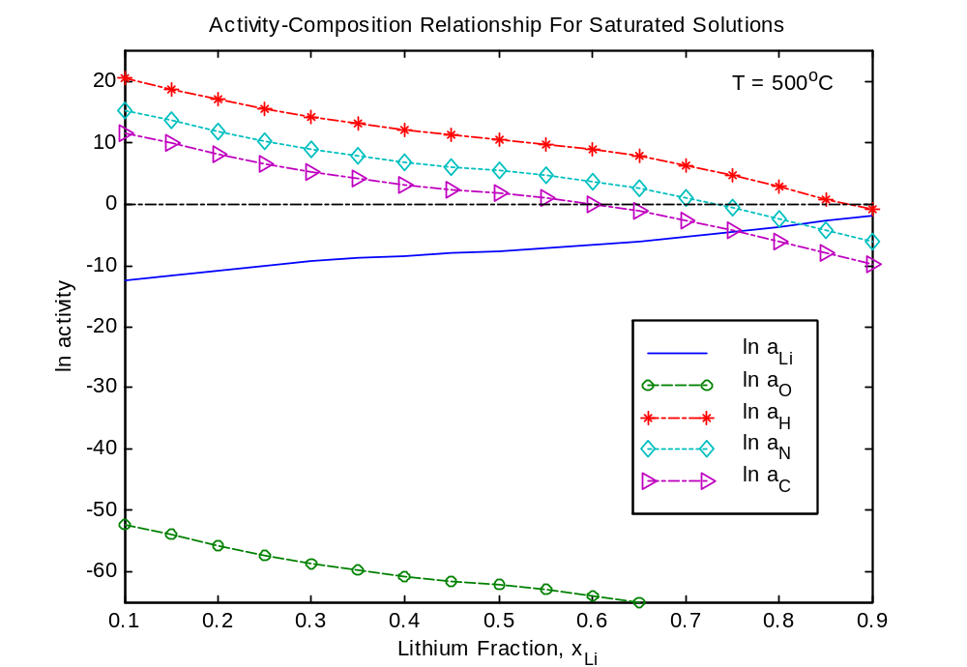
Activity-Composition Relationship for Saturated Solutions of O, H, N, and C at 773 K
Non-metals are increasingly in solution
(Salts:LiH, Li2C2,Li3N dissolve)
ln a_{H}
ln a_{Li}
Non-metals form
increasingly stable salts
(i.e.,Li2O)
ln a_{O}

Slide 16
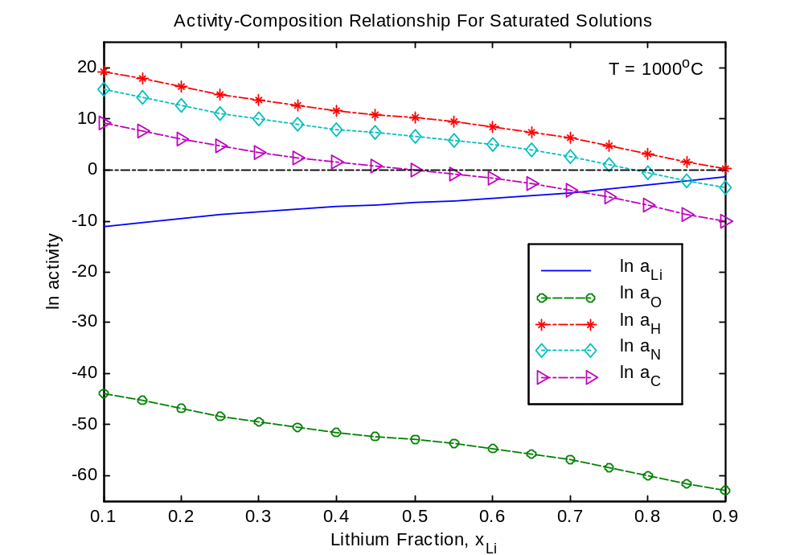
Activity-Composition Relationship for Saturated Solutions of O, H, N, and C at 1273 K
Non-metals are increasingly in solution
(Salts:LiH, Li2C2,Li3N dissolve)
ln a_{H}
ln a_{H}
ln a_{Li}
Non-metals form
increasingly stable salts
(i.e.,Li2O)
ln a_{Li}
ln a_{O}

Slide 17
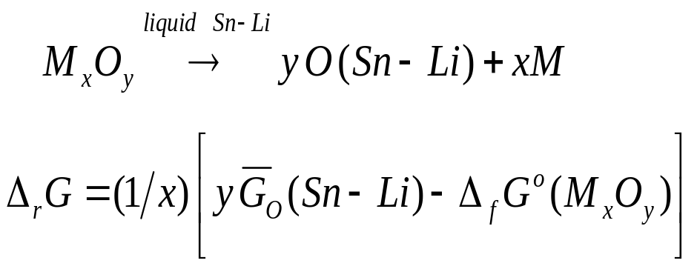

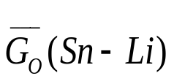
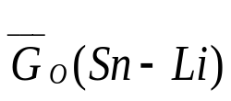
Thermodynamic Modeling of Chemical Stability of Coatings and Alloying Phases in Li and Sn-Li
Assess the chemical viability of oxide coatings in liquid Sn-Li, based on the free energy (_{r}G) changes of reactions :
where is the standard free energy of formation of the metal oxide, and is the solute (oxygen) free energy.
the oxide formation energies are taken from the JANAF tables (Slide 10)
however, the solute free energy has to be evaluated.

Slide 18
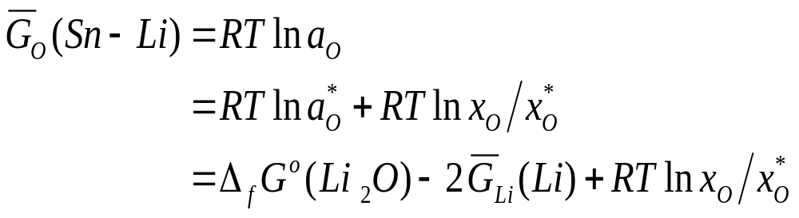




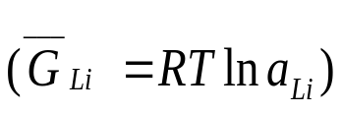
Solute Free Energies in Sn-Li
Expression to evaluate the solute (oxygen) free energy in Sn-Li :
where :
and: is the the partial free energy of dissolved lithium
: oxygen activity at saturation
: oxygen concentration
: oxygen concentration at saturation
Need the solubility data for non-metals in Sn-Li.

Slide 19
Solubility of Non-Metals in Sn-Li
Of the four lithium salts (LiH, Li₃N, Li₂C₂ , and Li₂O) only Li₂O is sufficiently stable to be formed in Sn-Li, the others decompose to saturated non-metal in solution:
[ is increasingly negative (see Slide 14-15) ]
The solubility of oxygen is very low in Sn:
  At 536, 600, and 700°C the solubility limit are 6  10⁻⁶, 2 10⁻⁴, and 6  10⁻⁴ at. %, respectively [1],
  and, the solubility of oxygen in Pb-Li is very low [2].
Therefore, we take the solubility of oxygen in Sn-Li also to be very low and express it by the well established solubility expressions in Li [3]:
    ln x_{O} = 1.428 – 6659 (T/K)⁻¹
    ln x_{N} = 2.976 – 4832 (T/K)⁻¹
    ln x_{C} = – 1.100 – 5750 (T/K)⁻¹
[1] T. N. Belford Trans. Faraday Soc. 61 (1965)
[2] M. G. Barker , Liquid Metal. Engr. (1984)
[3] p. Hubberstey, Liquid Metal Systems

Slide 20

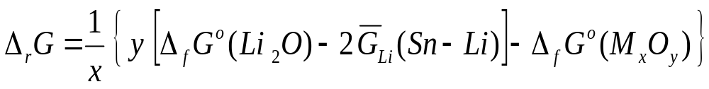
Thermodynamic Modeling of Chemical Stability of Coatings in Sn-Li
Because of the low oxygen solubility in Sn-Li, oxygen will be maintained at the saturated level (regardless of the purification);
And, because the lithium salts LiH, Li₃N, Li₂C₂ decompose readily (at x_{Li} < 0.65; T=500ºC), a simplified expression can be derived for the solute free energies:
which is valid for all four salts.
The free energy change of reactions for all four salts ((LiH, Li₃N, Li₂C₂ , and Li₂O)* can now be expressed as:
*Replace Li2O with the other salts
Slide#10
G_{Li}=RT ln a_{Li} (Slide # 7,10)
Slide#21

Slide 21
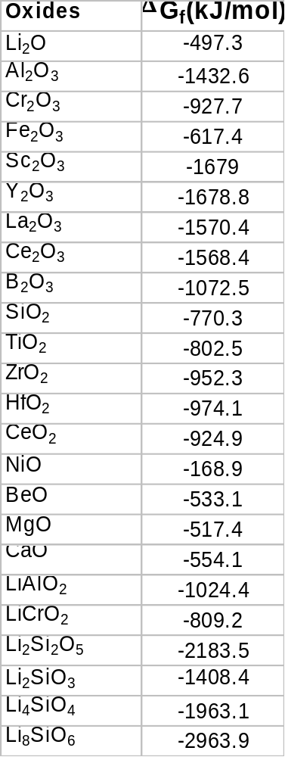
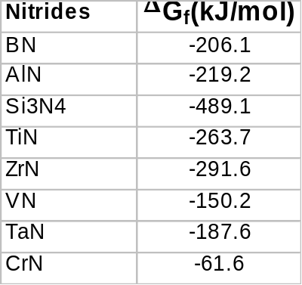
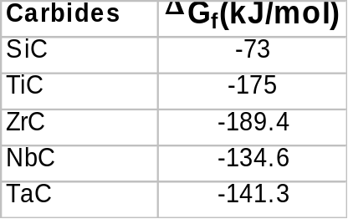
Gibbs Free Energy of Formation
The free energy of formation of some oxides, carbides, and nitrides at 773 K ^{[1]}.
[1] JANAF-Tables

Slide 22
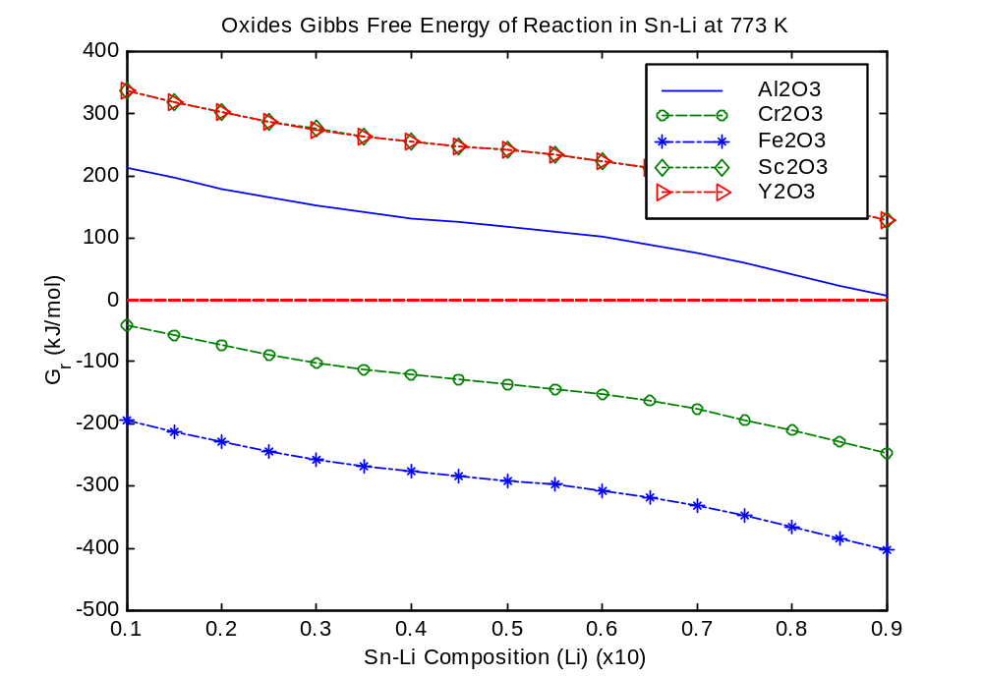
Change in Gibbs Free Energy of Reaction of Oxides in Sn-Li at 773 K
Increasingly
Stable Coating
Δ
Increasingly
Unstable
(decomposition)
Sn-Li 25
Sn-Li Composition (Li fraction)

Slide 23
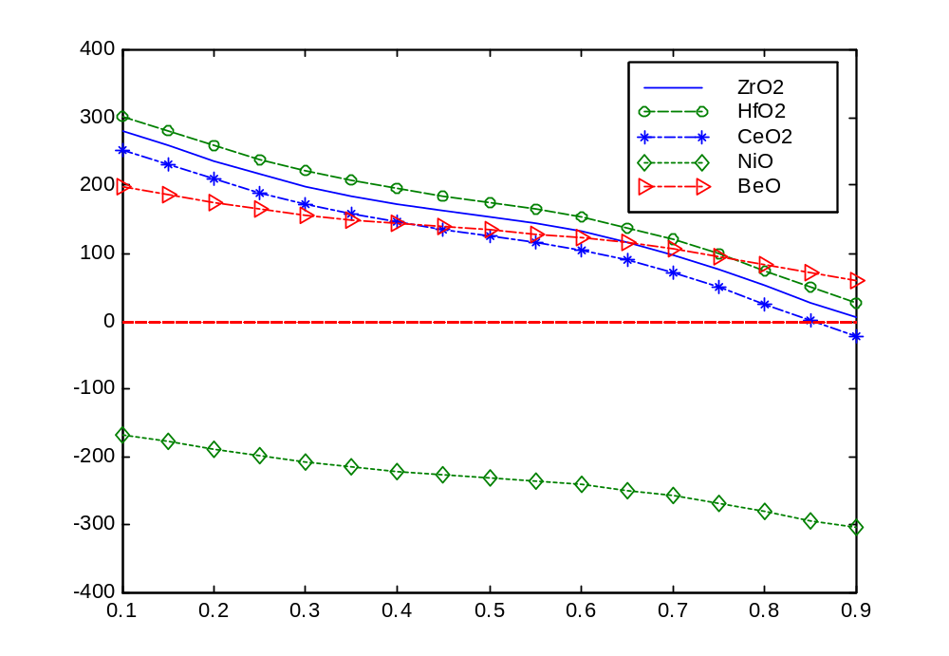
Change in Gibbs Free Energy of Reaction of Oxides in Sn-Li at 773 K
Increasingly
Stable Coating
ΔG (kJ/mol)
Increasingly
Unstable
Sn-Li Composition (Li fraction)
Sn-Li (Li at% fraction)

Slide 24
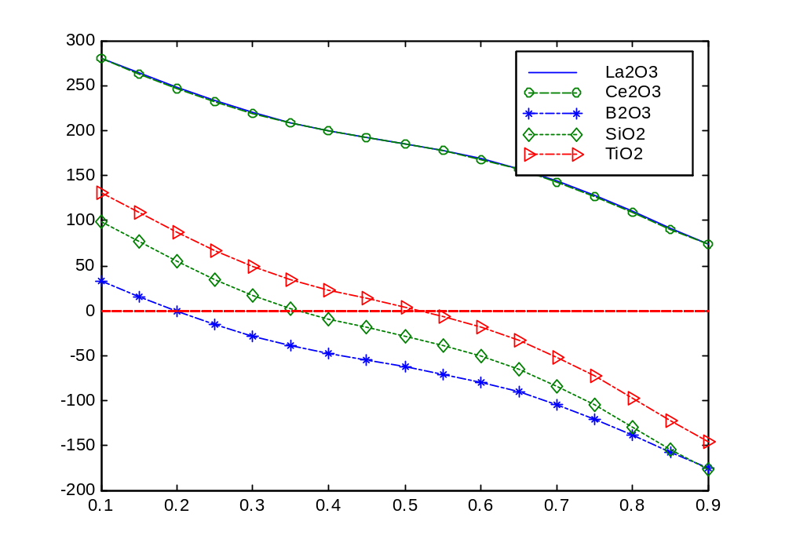
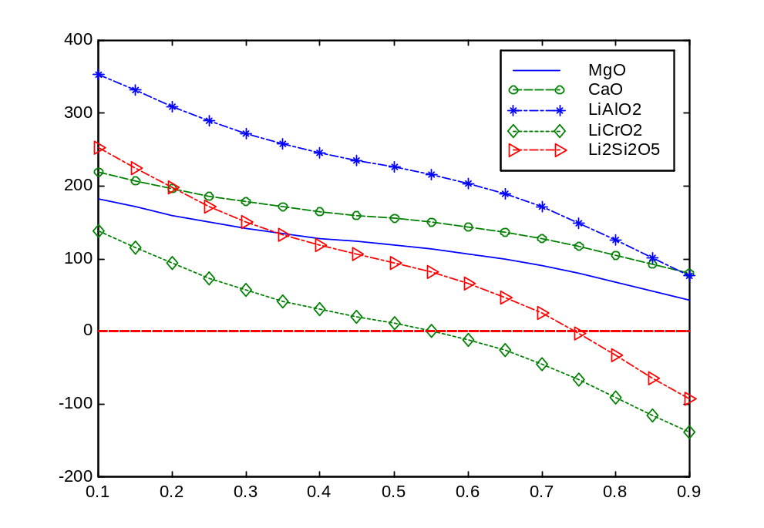
Change in Gibbs Free Energy of Reaction of Oxides in Sn-Li at 773 K
ΔG (kJ/mol)
ΔG (kJ/mol)
Sn-Li Composition (Li fraction)
Sn-Li (Li at% fraction X 10)
Sn-Li Composition (Li fraction)
Sn-Li (Li at% fraction X 10)

Slide 25
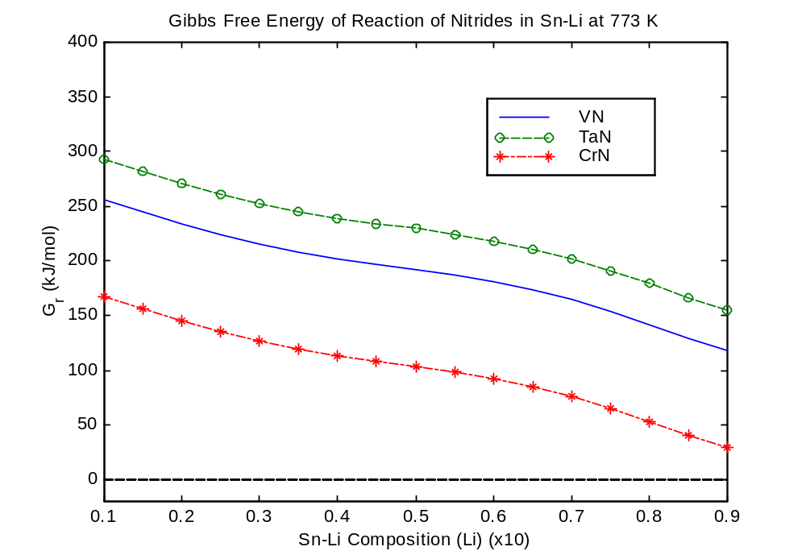
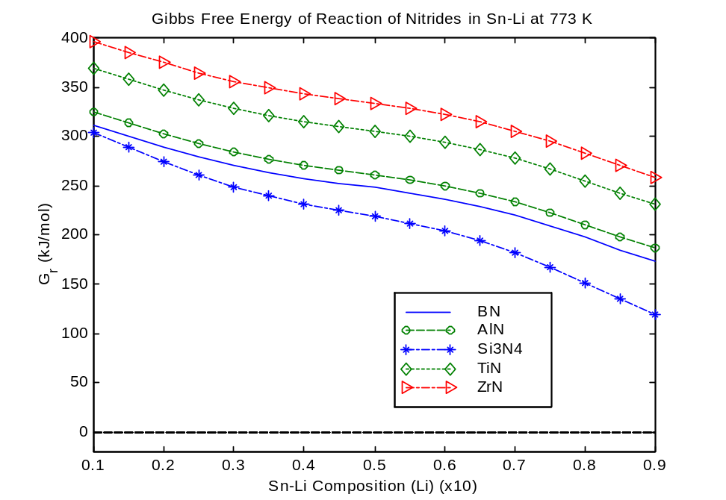
Change in Gibbs Free Energy of Reaction of Nitrides in Sn-Li at 773 K
Δ
Δ
Sn-Li Composition (Li fraction)
Increasingly Stable
Coatings
Sn-Li Composition (Li fraction)

Slide 26
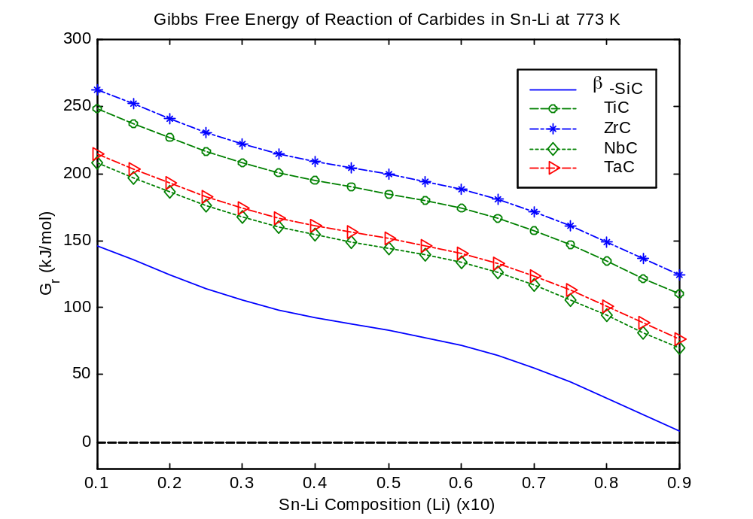
Change in Gibbs Free Energy of Reaction of Carbides in Sn-Li at 773 K
Δ
Increasingly
Stable Coating
Increasingly
Unstable
Sn-Li Composition (Li fraction)

Slide 27
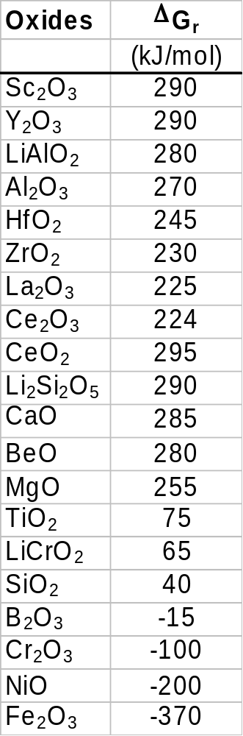
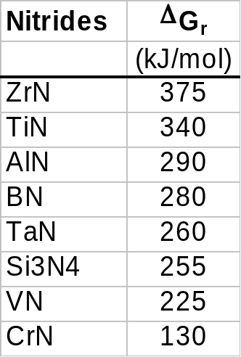
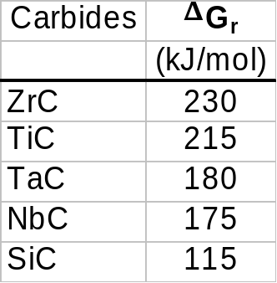
Stability of Oxides, Nitrides, and Carbides in Sn-Li at 773 K
Stability of Ceramic Coatings in Contact with Sn-Li 25 at.%
at 773 K in Descending Order:
Negative change in Gibbs free energy of reaction indicates unstable coating (decomposition).

Slide 28
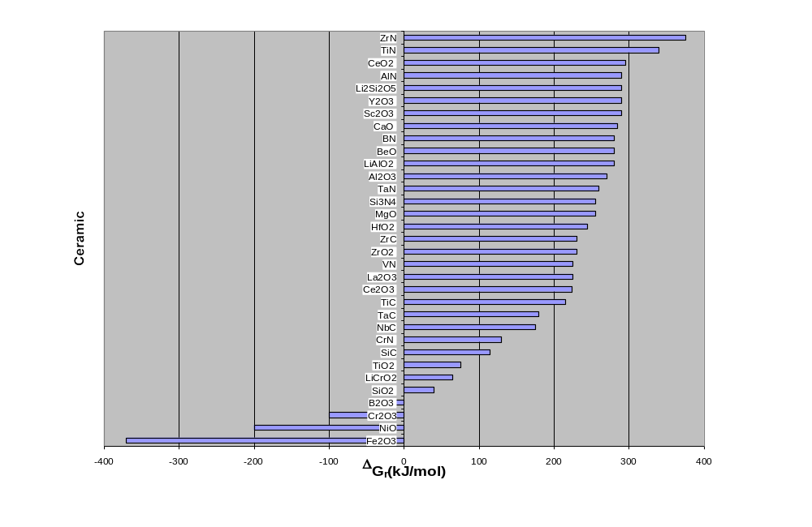
ΔG_{r}(kJ/mol) of Reaction at 773 K for Ceramics at Saturated Solutions in Sn-Li 25 at%
Unstable
Increasingly Stable

Slide 29
Uncertainties and Summary
Uncertainties:
  Extrapolation of Li-Activity Data from Pb-17Li
  Lack of solubility data for non-metals in Sn-Li
Summary:
  Established Li-activities for the entire temperature and composition range.
  Established solute (O, H, C, N) activities as a f (T,composition) in Sn-Li:
    Li₂O: Oxygen activity is very low every where; Li₂O formation is favored;
    very low dissolved oxygen.
    Li₂C₂: At high temperature (>1200ºC) Li₂C₂ is stable down to low Li-fractions (x_{Li}=0.10)
    → Carbide coatings should be resistant to dissolution in Sn-Li25 below 900ºC.
    Li₃N: At Li-fractions below 0.75 the formation of Li₃N is suppressed over the entire
    temperature range (600 – 1500ºC):
    → Nitride coatings should be resistant to dissolution even at high T in Sn-Li25.
    LiH: Hydrogen activities are positive for almost all Li-fractions and T-ranges.
    Hydride salt formation is suppressed (except for pure Li at low T<600ºC)
    → For Sn-Li25 Tritium recovery should not pose a problem.

Slide 30
Conclusions
Based on the low solubility of O, N, H, and C in Li, the following stability results are found for Oxide, Carbide, and Nitride Coatings in contact with Sn-Li (25at.%):
  Oxides:
    Fe₂O₃, NiO, and Cr₂O₃ will decompose at 500ºC.
    These will possibly corrode.
    All other oxides examined are stable.
    At 500ºC TiO₂, SiO₂, B₂O₃, LiCrO₂, Li₂Si₂O₅ are unstable at
    high Li-fractions (x_{Li}>0.2)
  Nitrides:
    At 500ºC all of the considered nitrides are stable.
  Carbides
    All are stable (except for β-SiC in pure Li)

Slide 31
Ongoing Work
More Accurate Thermodynamic Evaluations of Sn-Li on the basis of Phase Diagrams (CALPHAD method).
Investigating the Compatibility of Alloying Elements in Metals.
Erosion of Nozzles and High-Speed Zones (bends, contractions/expansions) due to formation of stable Li-compounds.
Analysis of FLiBe Thermodynamics of Compatibility.

